Slide 1

BIG DATA TECHNOLOGY
Install Kafka
Ref: https://blog.clairvoyantsoft.com/installing-apache-kafka-on-clouderas-quickstart-vm-8245d8d0ebe5
Notes:
https://blog.clairvoyantsoft.com/installing-apache-kafka-on-clouderas-quickstart-vm-8245d8d0ebe5

Slide 2
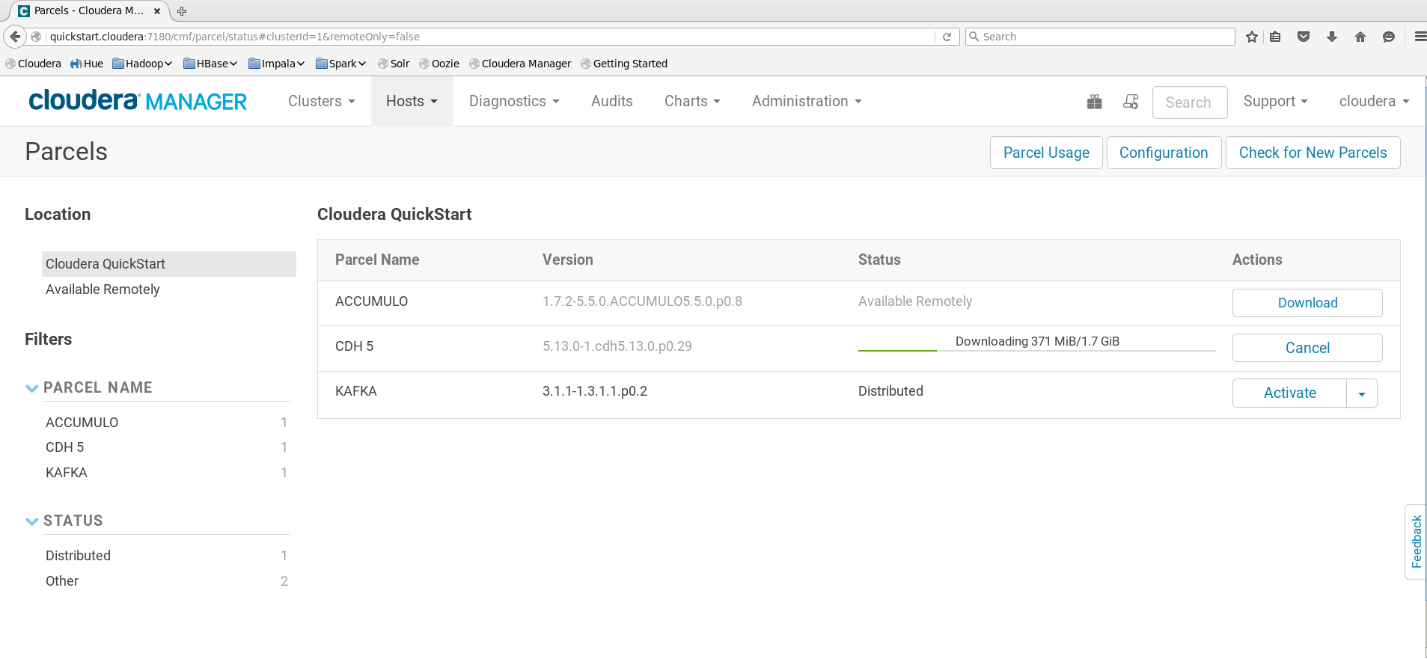

Slide 3
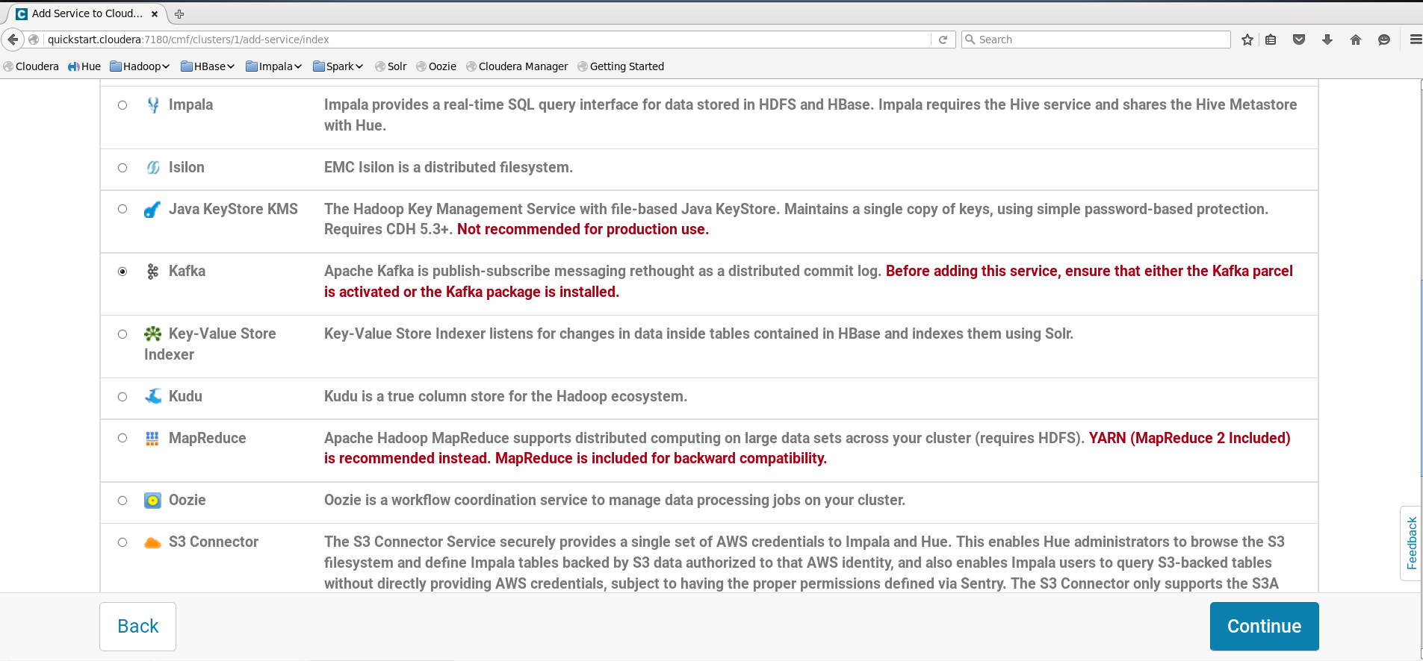

Slide 4
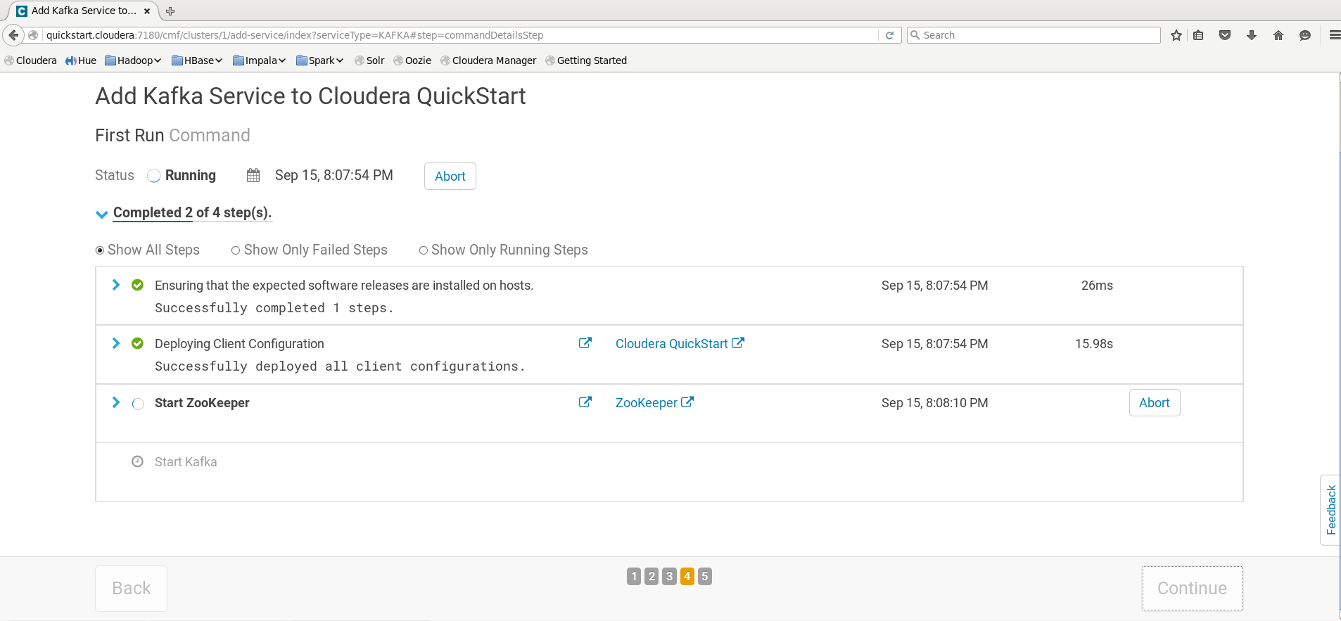

Slide 5
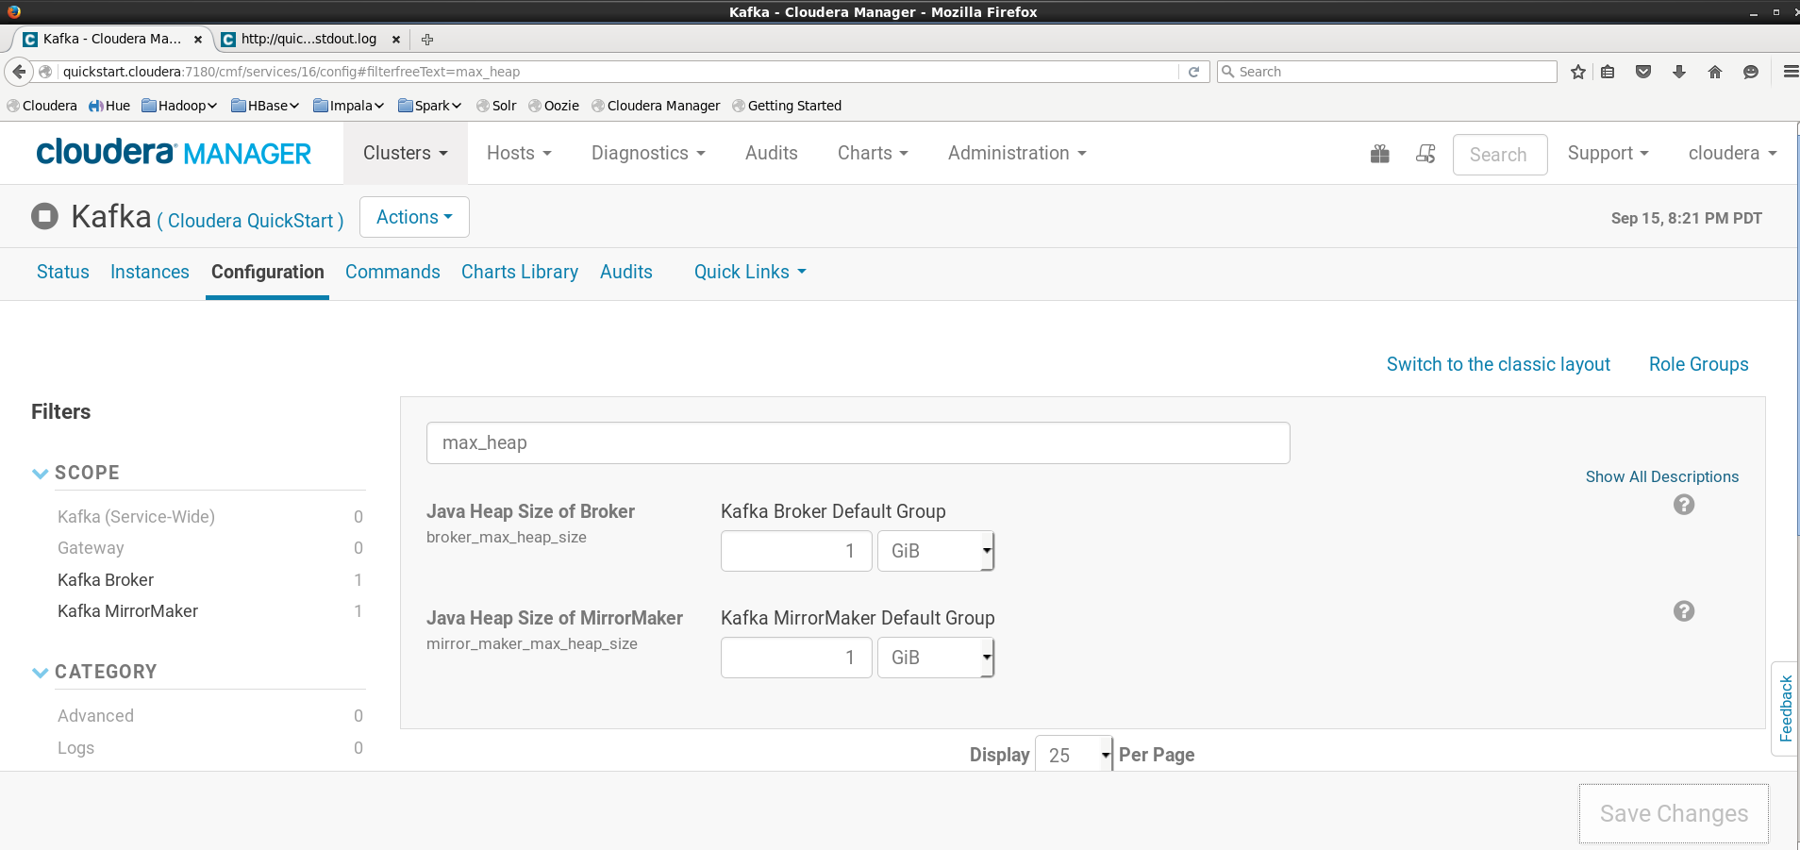
Notes:
https://stackoverflow.com/questions/36400366/kafka-configuration-on-existing-cdh-5-5-2-cluster
https://community.cloudera.com/t5/Support-Questions/CDH-5-7-kafka-parcel-add-service-throws-java-lang/m-p/40343

Slide 6
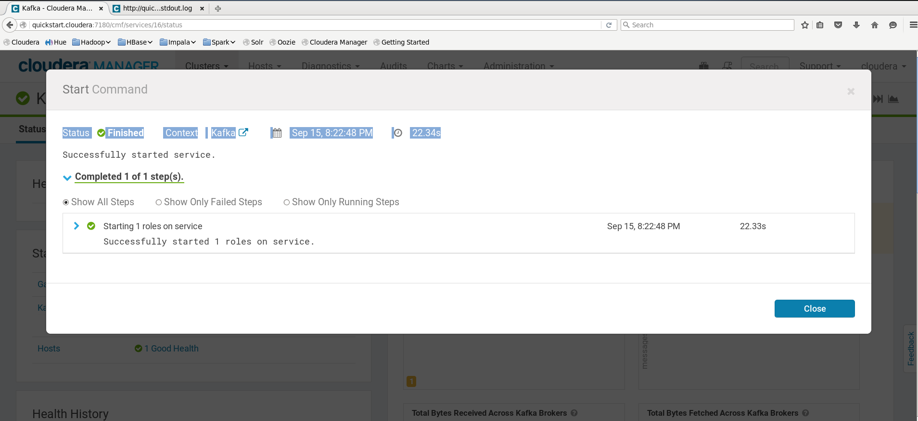

Slide 7
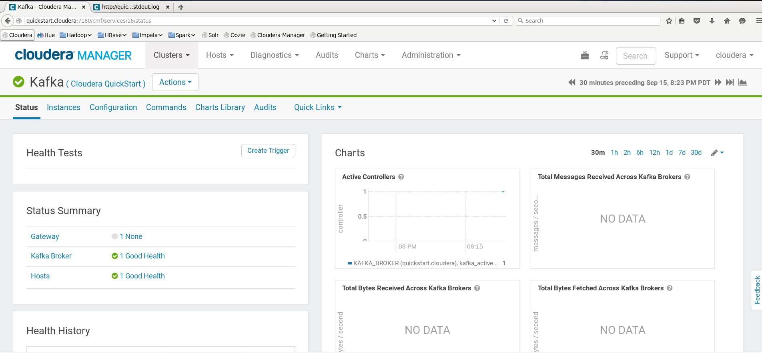

Slide 8
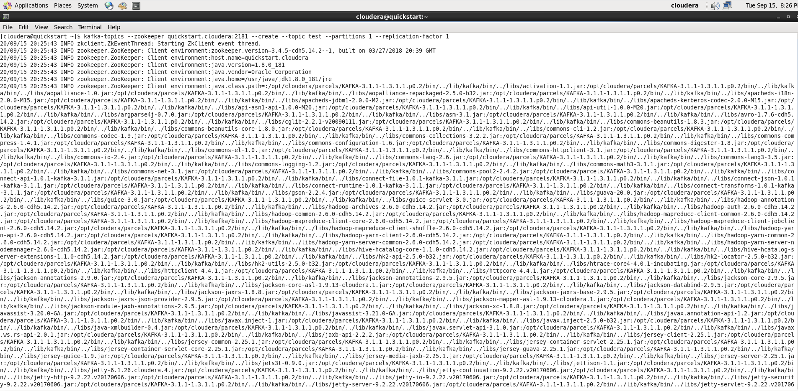

Slide 9
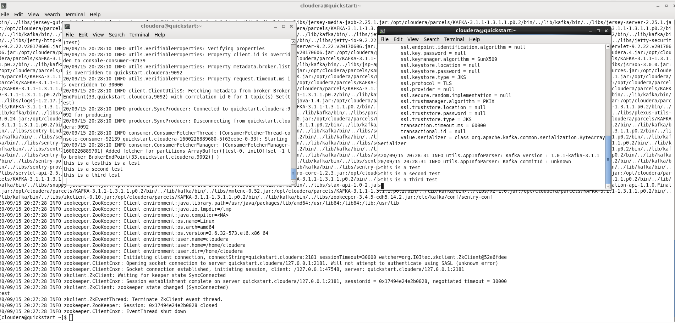
Kafka Service works.
Consumer
kafka-console-consumer --zookeeper quickstart.cloudera:2181 --topic test
Producer
kafka-console-producer --broker-list quickstart.cloudera:9092 --topic test

